Slide 1
CSE443 Summer Training on Machine Learning In Board Infinity
Project on:
Breast Cancer Prediction
using Python and Machine Learning.
By:Gundu Lalithendranath
Reg.no:11904466
Section:K19RD

Slide 2
INTRODUCTION TO BOARD INFINITY
BI is a platform where you can learn the courses of your interest with experts and get the job you are aiming for.
BI’s vision and mission is to personalize your career journey, help you realize true potential and meet your career dreams.
The platform was launched in year 2017 by the Chief Executing Officer and Co-founder Sumesh Nair. Since then, the company has seen massive growth of nearly 400% in the recent pandemic times.
Moderators help in resolving queries of students regarding subject and help students in connecting with coaches.

Slide 3
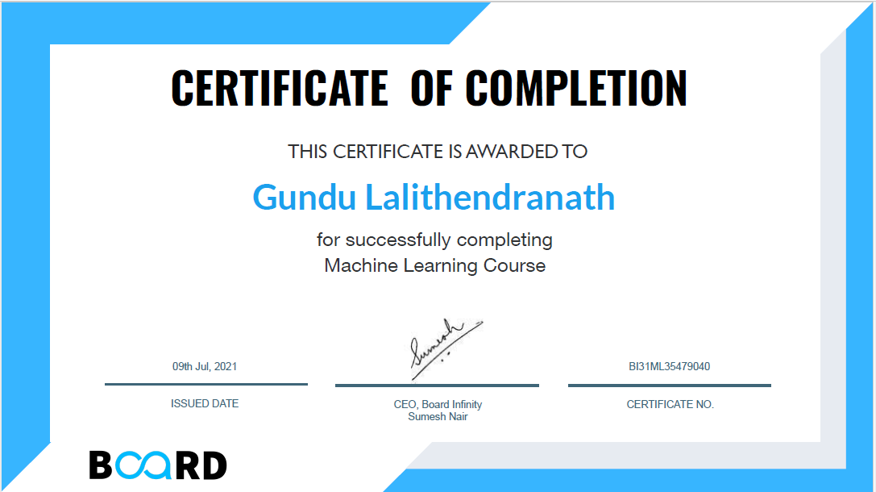

Slide 4
INTRODUCTION TO MACHINE LEARNING
In Todays era we can say that ML technology is the driving force and the future of miracles made by human intelligence integrated with machine power to make Artificial Intelligence Machines.
Machine learning provides system the ability to automatically learn and improve from experiences without being explicitly programmed. We create machines to think, act and solve like human without human intervention.
Machine learning focuses on the development of computer programs that can access data and use it to learn for themselves. It involves repetitive training to improve the learning and decision making of algorithms.

Slide 5
Types Of Machine Learning
Supervised Learning
Supervised learning is the machine learning task of learning a function that maps an input to an output based on example input-output pairs like prediction of prices, weather forecasting, population growth.
Unsupervised learning
Unsupervised learning is the training of machine using information that is neither classified nor labeled and allowing the algorithm to act on that information without guidance like clustering algorithms.
Reinforcement Learning
Reinforcement Learning is a type of Machine Learning that allows the learning system to observe the environment and learn the ideal behavior based on trying to maximize the learning based on penalty and rewards like self-driving cars.

Slide 6
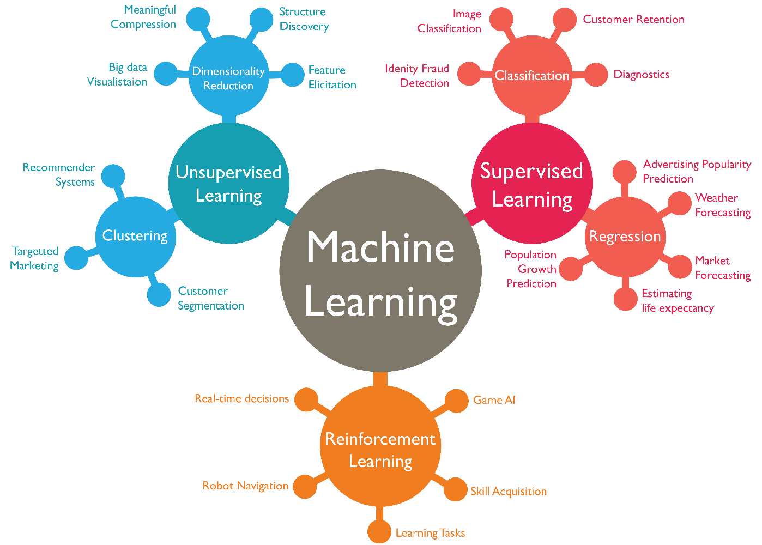
Applications Of ML

Slide 7
INTRODUCTION TO THE PROJECT
BREAST CANCER PREDICTION

Slide 8
Breast cancer prediction
Out of many types of cancers Breast Cancer is one. In this type of cancer basically the breast(mammary glands) of the patient is affected. This type of cancer can be seen in females and very rarely in males.
This happens when some breast cells grow abnormally and causes a bit of inflammation or pain in the breast.
There are two type of tumor.
1)Benign this type of tumor is also known as non-cancerous cells. These tend to grow slowly and do not spread also they are not at all harmful.
2) Malignant this type of tumor is also called as cancerous cells. These tend to grow rapidly, if neglected this can invade and destroy nearby normal tissues and spread through out the body.
In my project we are going to predict whether the patient is affected with Benign or Malignant based on inputs and other parameters.

Slide 9

Execution of the project
Importing the libraries and loading the dataset
I have taken my dataset the breast cancer prediction from
famous database called Kaggle. From there I have downloaded
the csv file and load in my jupyter notebook using pandas
dataframe for data manipulation and cleaning.
I have included numpy library as well for data manipulation,
cleaning and to perform all statistical analysis on the dataset.
I have also include matplotlib and seaborn for data visualization
through graphs and charts.

Slide 10

2. Preprocessing of the Data
The data that we get will not always be clean in
real world we get NaN values, empty values etc.
we need to remove these values as these may hamper
the model to produce accurate predictions
We also need to check the datatypes are mentioned
correctly or not. And also need to change them
accordingly as we need for manipulations.
Here our target variable is diagnosis column

Slide 11
Creating the model
I have created a Logistic Regression model of supervised learning. As we have a
labelled data and also we give the model input as well as output to the model and predict
the target variable.
Models learn from the training data and makes patterns for the prediction of testing data.
we have categorical data like in our dataset M represents Malignant and B represents
Benign.
As we have only 2 categorical data we use LabelEncoder() from sklearn.preprocessing
library to convert the data to binary format. Here after, 1 represents Malignant and 0
represents Benign. This is also a classification problem.
I have also created Decision Tress model and RandomForest model for comparison as they
are also from supervised learning.

Slide 12
4. Training the model
We will split the data and store the values of the target variable in Y and
rest of the features that are helpful in determining the target variable in X.
We import train_test_split() from sklearn.model_selection library and use it
to train the model in 60 40 ratio like 60% for training and 40% for testing.
I have used 60 40 ratio as it is giving accurate predictions.
using StandardScale we transform X_train and X_test values. By using
LogisticRegression() from sklearn.linear_model and using log.fit() function
we train the model from X_train and Y_train values and feed the model.

Slide 13
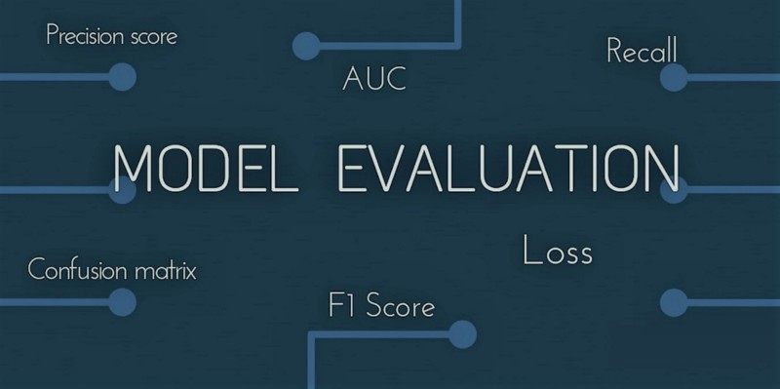
5. Evaluate the Model
using accuracy_score() function and by using Y_test
and predicted values of X_test as parameters.
We compare the Y_test values with predicted values
of X_test and get accuracy score of model.
After this we can also print values of Y_test and the
values of predicted X_test and view and compare
them visually.

Slide 14
Future Scope and applicability
This mini-project is a basic step for understanding the prediction. How the perdiction are
done using dependent(Target) variable and independent variables.
In this project we have mainly used Logistic regression model of binary classification of
only 2 variables(M and B).
This project that I had done is massively helpful in medical industries to determine whether
a patient is affected with breast cancer or not with in few minutes with higher percentage
of accuracy.
This project exposed me to other similar projects like bitcoin price prediction, weather
prediction etc.

Slide 15
THANKYOU
Gundu Lalithendranath
11904466
K19RD

